Slide 1
uop
For dfu&soc station

Slide 2
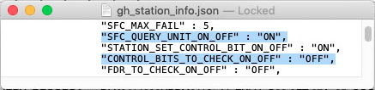
Ready?
1.看线体UOP&CB设置 – 控制变量
验UOP:
UOP->ON
CB_CHECK->OFF
发邮件找PDCA Team帮忙设置
Dir:/vault/data_collection/test_station_config/gh_station_info.json
2.查完全fresh板的UOP能不能拦截跳工站
除ICT是“OK”, 其他工站都应该报 “ICT no PASS record”
初步验证UOP是否打开
1.找线长要完全fresh的SN
2.在172网段输入橙色框里的URL
3.绿色字符位置替换为正确值
4.查看返回值是否为ICT no PASS record
"SFC_URL"@gh_station_info.json
Fresh MLB SN
http://172.16.241.131/mlbpx?c=QUERY_RECORD&sn=DLX0414000YPPM011&tsid=FXLH_G02-3FT-07A_25_DFU-NAND-INIT&p=unit_process_check
"STATION_ID"@gh_station_info.json

Slide 3
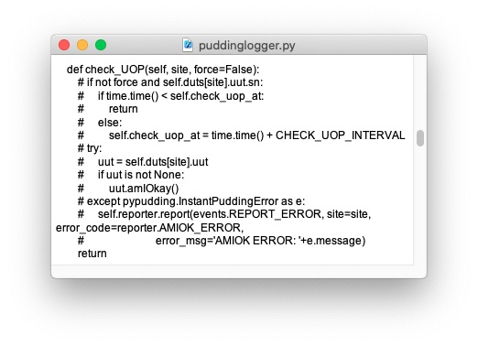
Ready?
3.确认厂商软体UOP拦截有没有开 (Atlas2玩家可跳过这一步骤)
DFU@MircoTest：
/Users/gdlocal/Public/python-sequencer
/x527/loggers/puddinglogger.py
如右图
DFU@SunCode：
跟随gh_station_info.json中UOP的设置
相关函数被写进了scan SN的测试项
SOC@Atlas：
跟随gh_station_info.json中UOP的设置
这里代码被注释，删掉 # 即为开启UOP拦截

Slide 4
GO!
1. ICT no PASS record. Goto ICT
2. No response from SFC
3. NOT vaild in the gh_station_info.json file
4. [AAB] Goto different DFU-NAND-INIT
5. Over fail count. Goto FA-CHECK-IN
6. Must check out at FA-CHECK-OUT
7. ICT no PASS record . Goto ICT
跳工站 for fresh
断网
gh_station_info.json 文件内容有缺失
同机台连续Fail2次，还搁这测第三次
Fail的次数满3次，还测第四次
未check out FA就在正常机台上测试
跳工站 for checkout FA

Slide 5







当前PPT附的截图和Step预期结果有差异
是因为之前不同的操作流程
LA验完之后会更新截图
1.务必带上桌面壁纸右上角那一堆机台信息
2.关键message选中高亮截图
3.Insight截图把工站, 测试时间, Failure Symptoms show出来
4.按照图鉴里的命名方式给截图命名
5.OSX选区截图快捷键: Shift_cmd_4
OSX窗口截图快捷键: Shift_cmd_4; space
OSX全屏截图快捷键: Shift_cmd_3

Slide 6








1.Validation MLB两片 - 完全fresh的MLB(未测ICT/offline ICT)
后文简称为VMLB
2.Validation Fixture两台 – 修改RTOS image的内容造成Enter RTOS fail
后文简称为VFIXT-A和VFIXT-B
3.正常测试Fixture一台 – follow online
后文简称为FIXT-C

Slide 7
1) Bobcat Routing_Control
现象: ICT no PASS record. Goto ICT
实质: 跳工站
Step1: VMLB在DFU Only restore(offline) + 手动写SN + 读全部CB
0x00 Untested
0x0A Untested
:-) rtc --set 20211115151403
:-) syscfg init
:-) cbinit
:-) syscfg add MLB# DLX1234567890ABCD
:-) cbreadall
手动=上电UART进Diags
Step2: DFU正常测试, 正常情况下会弹框终止测试
弹框UOP:ICT no PASS record
0x00 Untested
0x0A Untested
Step3: 手动读全部CB :-) cbreadall
Step4: Dir:/vault/data_collection/InstantPudding.log找到报IP error的信息
ICT no PASS record
FATAL ERROR
Step5: Insight查找SN测试信息

Slide 8
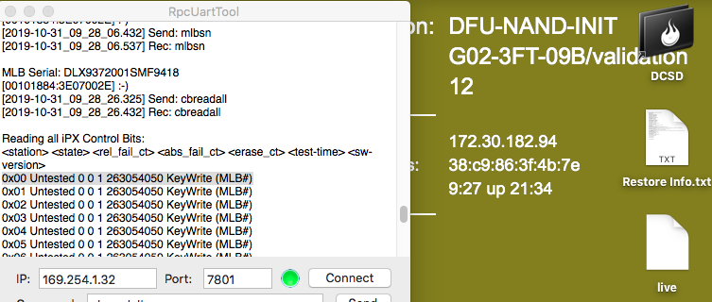
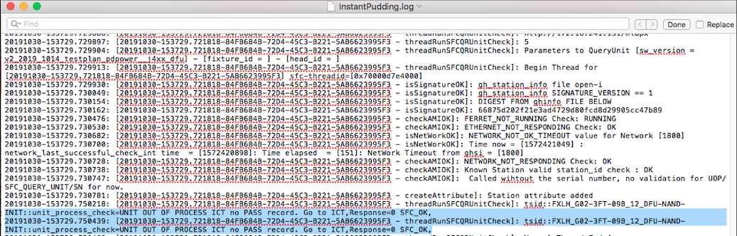
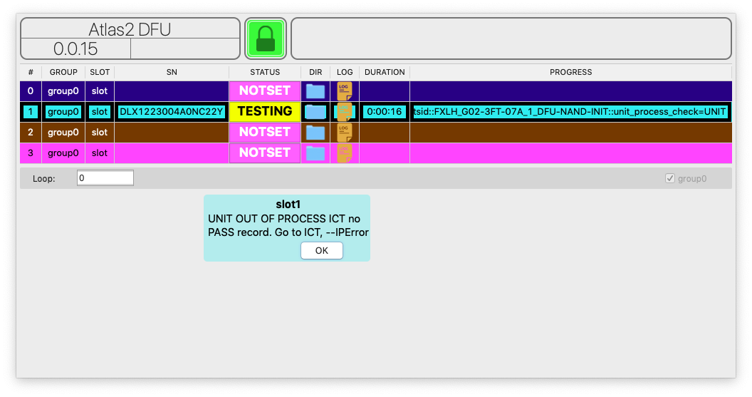
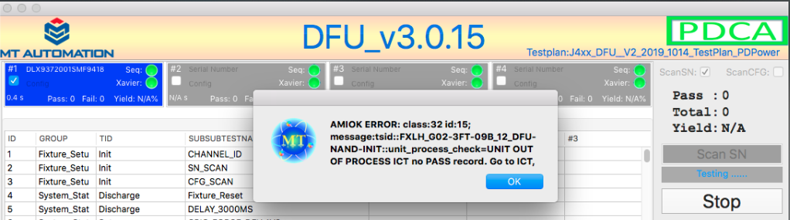
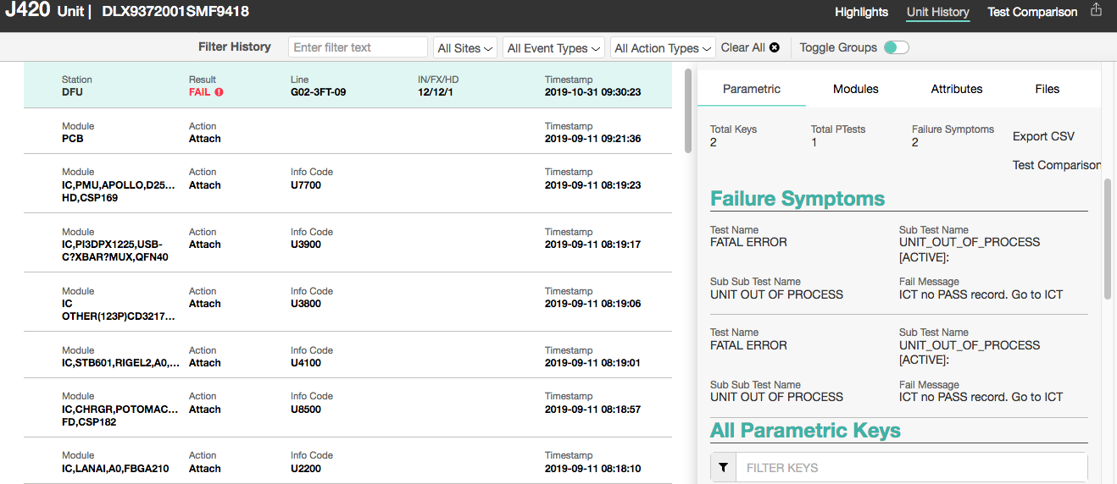
1) Bobcat Routing_Control
图1.Before test CB status
FolderName: 1.Bobcat Routing_Control
图4.IP error message result
Dir:/vault/data_collection/InstantPudding.log
图2.Tester UI result
图5.Insight result
图3.After test CB status

Slide 9
2) Bobcat RETEST_aab
现象1: [AAB] Goto different DFU-NAND-INIT
实质: 同机台连续Fail2次，还搁这测第三次(需要排除机台导致的fail)
0x00 Untested
0x0A Passed
Step1: VMLB去ICT上传PASS记录, 手动cbreadall
界面Fail_0x00-Failed111
界面Fail_0x00-Failed221
界面Fail_弹框AAB
Step2: 在DFU VFIXT-A连续测试3次, 每一次测试界面UI+手动cbreadall
正常情况下第3次会弹框终止测试
Step3: 摁掉弹框后手动cbreadall
0x00-Failed221
Step4: Dir:/vault/data_collection/InstantPudding.log找到报IP error的信息
AAB
Step5: Insight查找SN测试信息
FATAL ERROR

Slide 10
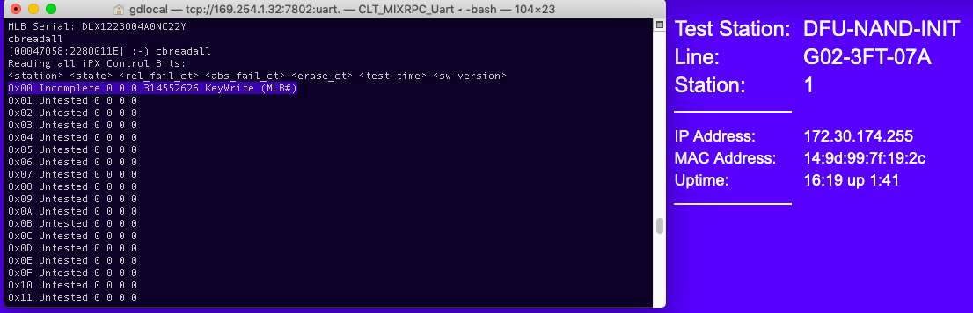
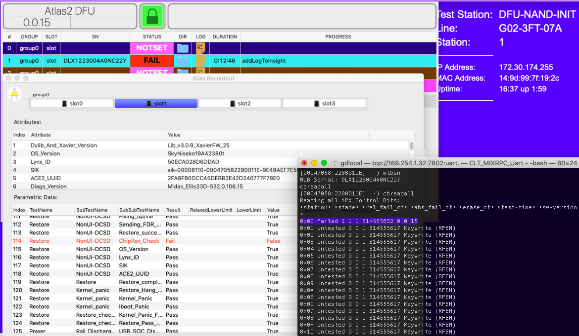
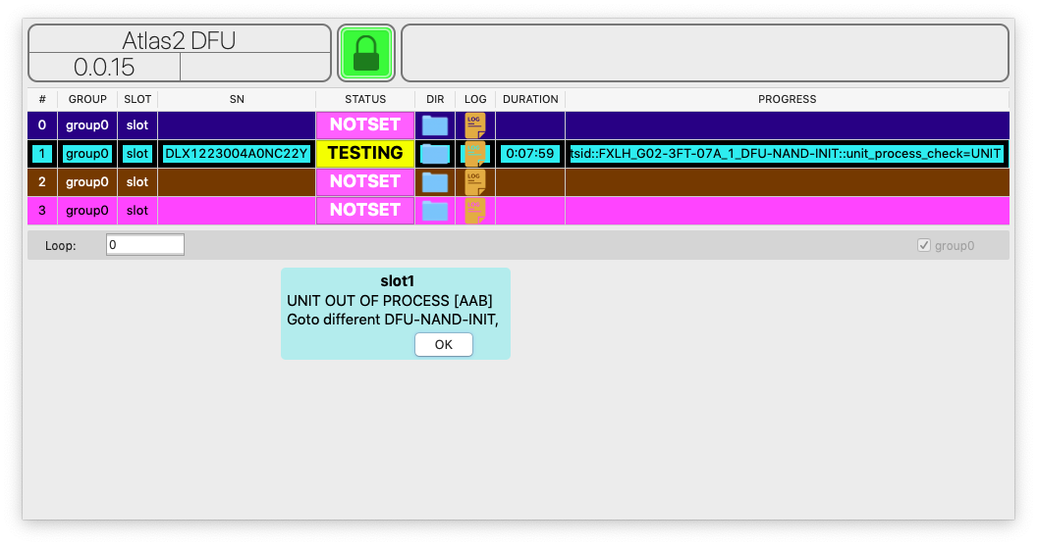
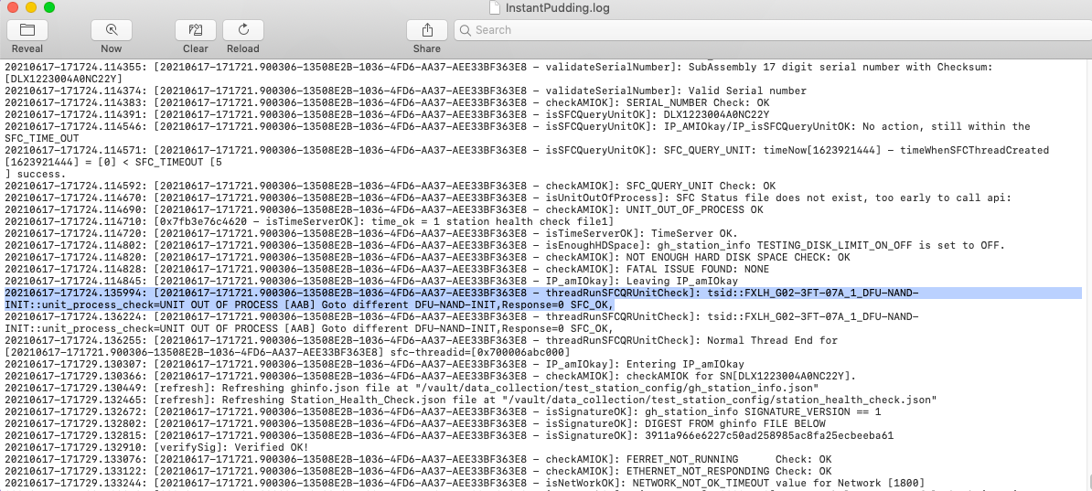
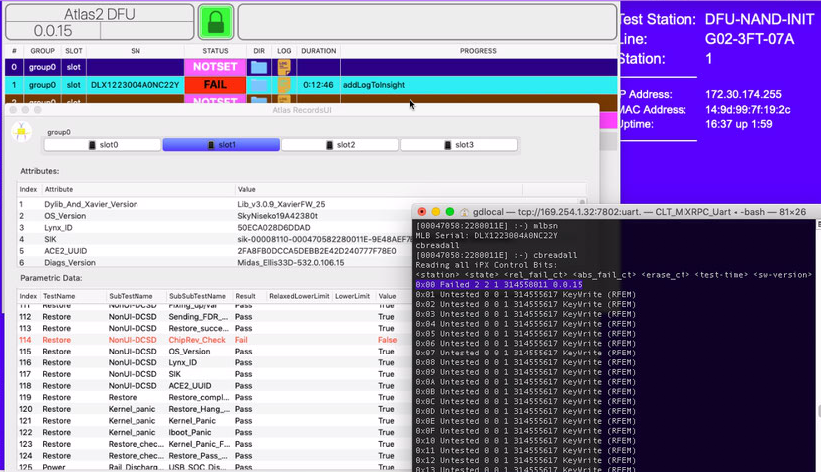
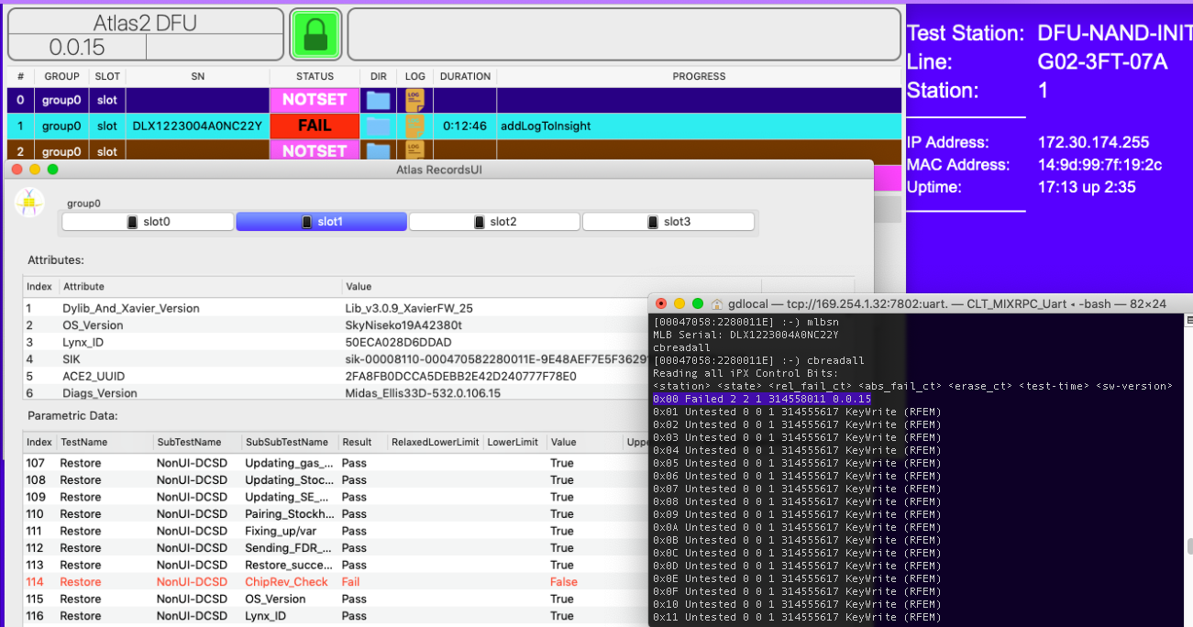
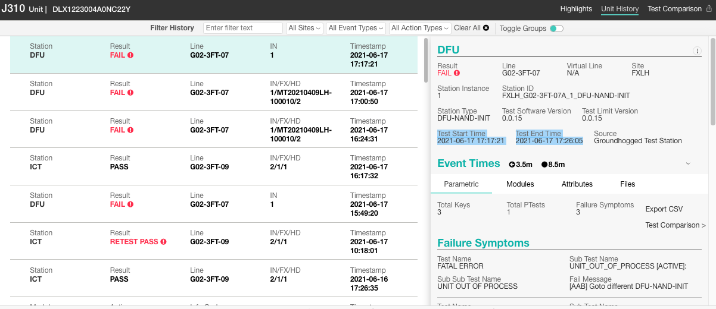
2) Bobcat Retest_aab
图1.Before test CB status
FolderName: 2.1.Bobcat Retest_AAB
图2.A test 1 time UI and CB result
图4. A tests 3 times UI
图6.IP error message result
Dir:/vault/data_collection/InstantPudding.log
图5.After test CB status
图3. A tests 2 times UI and CB result
图7.Insight result

Slide 11
2) Bobcat RETEST_FA-check-in
现象2: Over fail count. Goto FA-CHECK-IN
实质: 连续Fail3次，还不快去送FA
界面Fail_0x00-Failed331
Step1: 在VFIXT-B测试, 手动cbreadall
Step2: 在VFIXT-B再测一次, 该弹框了
界面Fail_弹框FA-CHECK-IN
0x00-Failed331
Step3: 摁掉弹框后手动cbreadall
Step4: Dir:/vault/data_collection/InstantPudding.log找到报IP error的信息
FA-CHECK-IN
Step5: Insight查找SN测试信息
FATAL ERROR

Slide 12
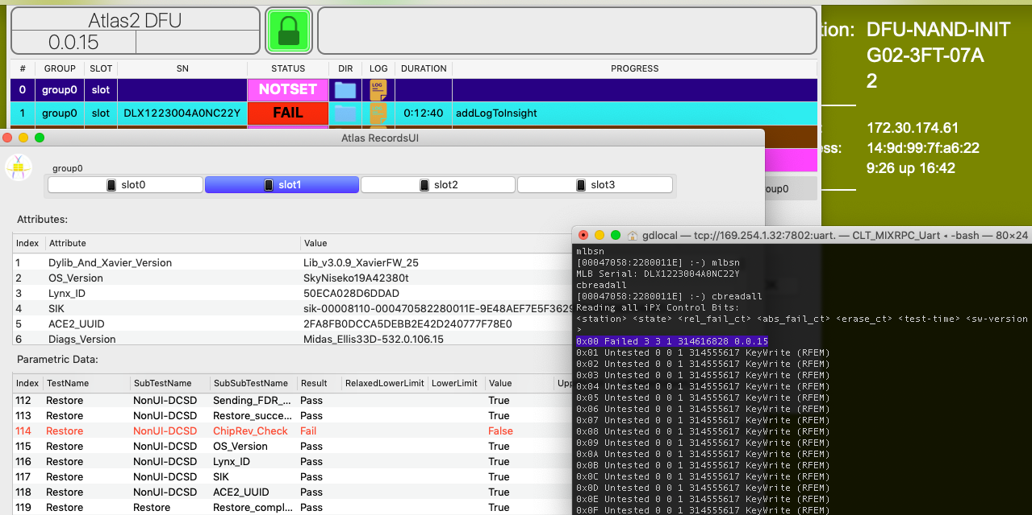
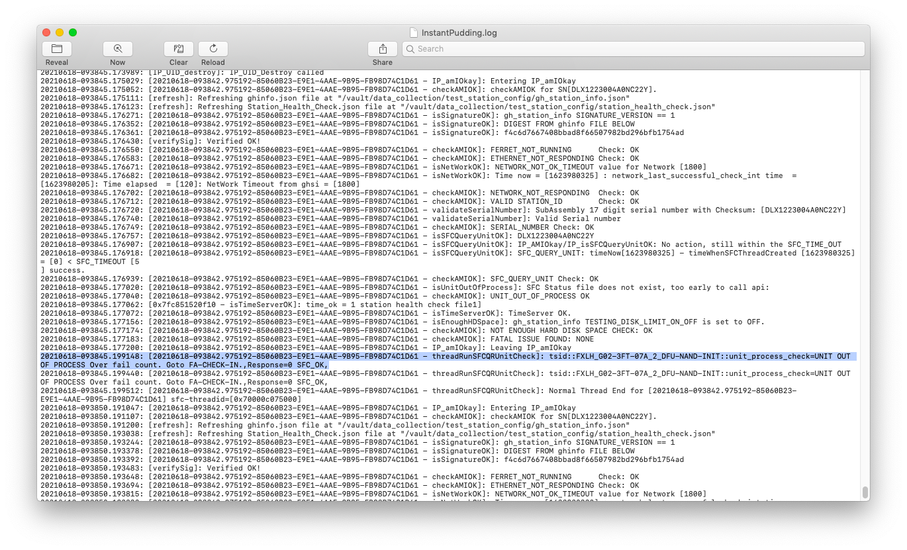
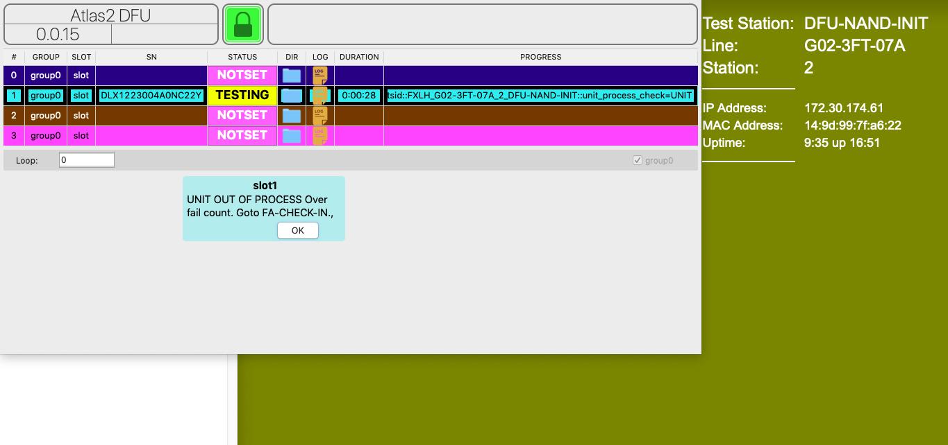
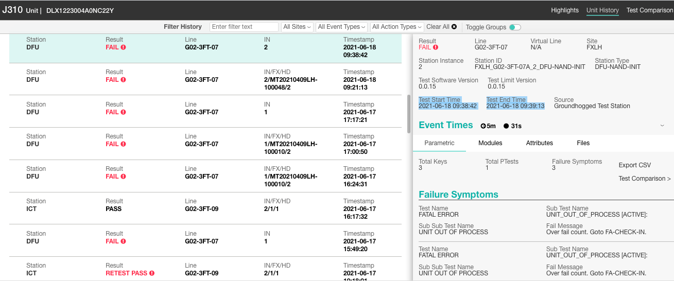
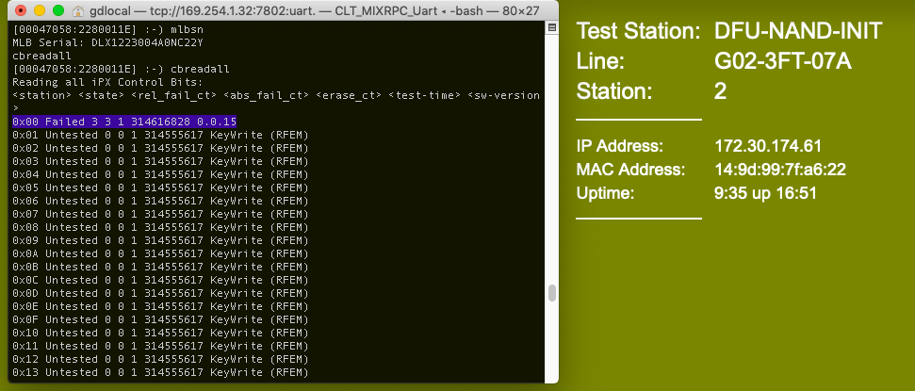
2) Bobcat Retest_FA-check-in
图1.B test 1 time UI and CB result
FolderName: 2.2.Bobcat Retest_FA-CHECK-IN
图4.IP error message result
Dir:/vault/data_collection/InstantPudding.log
图2.B test 2 times UI
图5.Insight result
图3.After test CB status

Slide 13
2) Bobcat Retest_A-FA(SOC专属)
现象2: Over fail count. Goto FA-CHECK-IN
实质: 只允许fail一次，还不快去送FA
Step1: 在SOC测试前, 手动cbreadall
Step2: 修改SOC TestPlan-第一个sc run命令的期望值改成错误的, 连续两次测试
1.第一次测试界面Fail_0x02-Failed111
2.第二次测试弹框FA-CHECK-IN
Step3: 摁掉弹框后手动cbreadall
0x02-Failed111
Step4: Dir:/vault/data_collection/InstantPudding.log找到报IP error的信息
FA-CHECK-IN
Step5: Insight查找SN测试信息
FATAL ERROR

Slide 14
2) Bobcat Retest_A-FA(SOC专属)
图1.Before test CB status
FolderName: 2.3.Bobcat Retest_A-FA
图5.IP error message result
图2. Test fail 1x and CB result
Dir:/vault/data_collection/InstantPudding.log
图3. Test fail 2x
图6.Insight result
图4.After test CB status

Slide 15
3) Bobcat_fa-check-out
Before
现象: Must check out at FA-CHECK-OUT
实质: 还没从FA送出来, 不能参与正常测试
即使ICT的CB是pass的，UOP也只认上传的数据
0x00-Failed331
0x0A-Passed
Step1: 把VMLB CHECK-IN-FA后直接拿出来手动cbreadall
Step2: 在任意机台测试, 该弹框了
界面Fail_弹框FA-CHECK-OUT
Step3: 摁掉弹框后手动cbreadall
0x00-Failed331
Step4: Dir:/vault/data_collection/InstantPudding.log找到报IP error的信息
FA-CHECK-OUT
FATAL ERROR
Step5: Insight查找SN测试信息

Slide 16
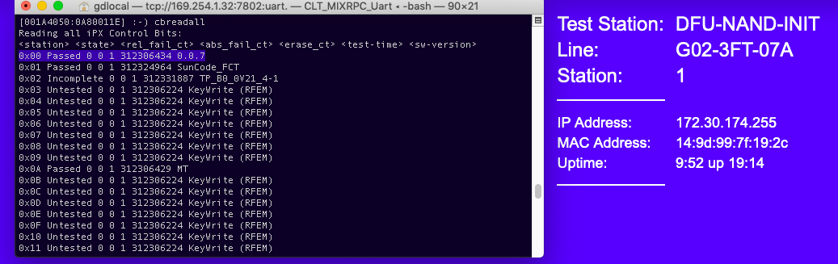
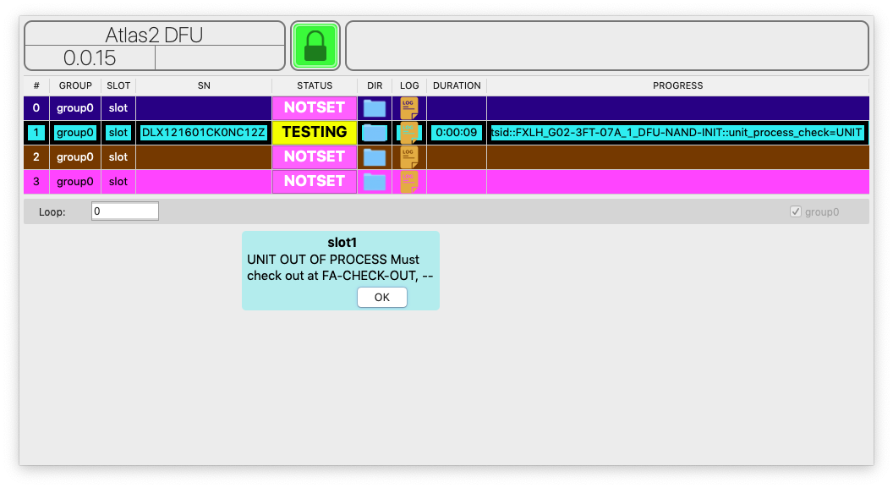
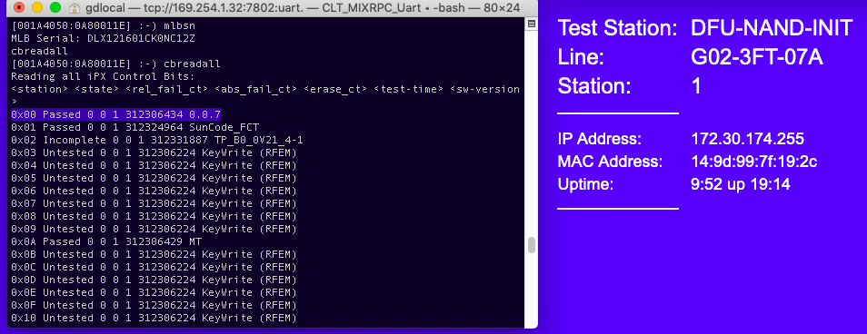
3) Bobcat_FA-check-OUT_BEFOER
图1.Before test CB status
FolderName: 3.1.Bobcat_FA-CHECK-OUT_Before
图4.IP error message result
Dir:/vault/data_collection/InstantPudding.log
图2.Tester UI result
图5.Insight result
图3.After test CB status

Slide 17
3) Bobcat_fa-check-out
After
现象: ICT no PASS record. Goto ICT
实质: 从FA签出后未按测试流程从ICT开始
0x00-Failed331
0x0A-Passed
Step1: VMLB去ICT上传PASS记录后手动cbreadall
Step2: 在任意机台测试, 该弹框了
界面Fail_弹框ICT no PASS record
Step3: 摁掉弹框后手动cbreadall
0x00-Failed331
Step4: Dir:/vault/data_collection/InstantPudding.log找到报IP error的信息
ICT no PASS record
FATAL ERROR
Step5: Insight查找SN测试信息

Slide 18
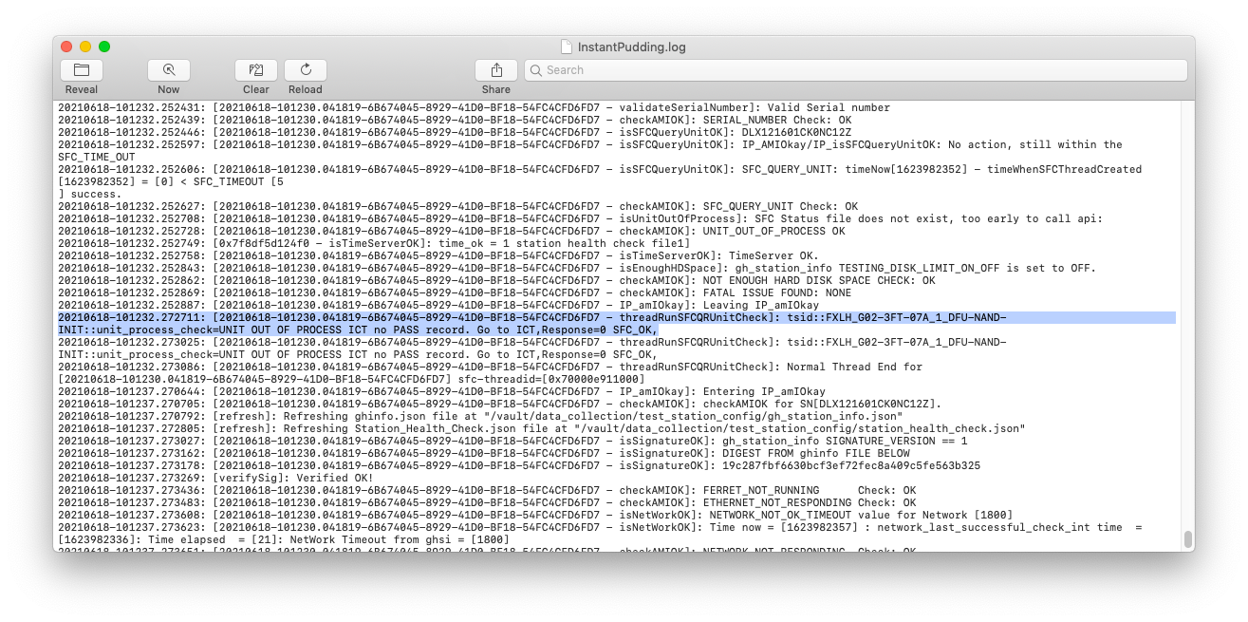

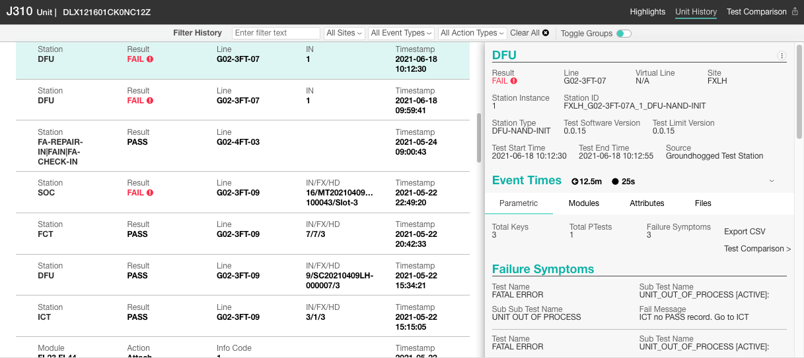
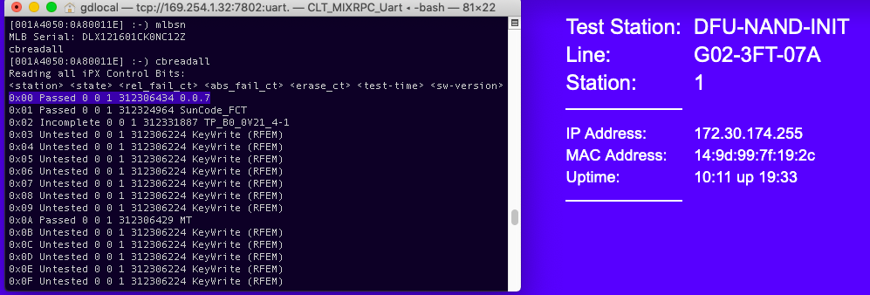
3) Bobcat_FA-check-OUT_after
图1.Before test CB status
FolderName: 3.2.Bobcat_FA-CHECK-OUT_After
图4.IP error message result
Dir:/vault/data_collection/InstantPudding.log
图2.Tester UI result
图5.Insight result
图3.After test CB status

Slide 19
4) FE SFC_QUERY_UNIT
现象: SFC_QUERY_UNIT no Response
实质: 断网了
0x00-Failed331
0x0A-Passed
Step1: VMLB手动cbreadall
Step2: 拔掉FIXT-C网线, 等壁纸变红后测试
界面Fail
Step3: 摁掉弹框后手动cbreadall
0x00-Failed331
Step4: Dir:/vault/data_collection/InstantPudding.log找到报IP error的信息
ICT no PASS record
FATAL ERROR
Step5: Insight查找SN测试信息

Slide 20
4) FE SFC_QUERY_UNIT
图1.Before test CB status
FolderName: 4.FE SFC_QUERY_UNIT
图4.IP error message result
Dir:/vault/data_collection/InstantPudding.log
图2.Tester UI result
图5.Insight result
图3.After test CB status

Slide 21
5) FE INVALID_SIGNATURE
现象: Signature NOT OK
实质: “gh_station_info.json”签名比对异常
0x00-Failed331
0x0A-Passed
Step1: VMLB手动cbreadall
截图含”signature”:”****”
Step2: Dir:/vault/data_collection/test_station_config/gh_station_info.json
Step3: 删掉signature的值
截图含”signature”:””
界面Fail_0x00 Failed331
Step4: 在FIXT-C进行测试, 测完手动cbreadall
Step5: Dir:/vault/data_collection/InstantPudding.log找到报IP error的信息
Invalid Signature
FATAL ERROR
Step6: Insight查找SN测试信息

Slide 22
5) FE INVALID_SIGNATURE
图1.Before test CB status
FolderName: 5.FE INVALID_SIGNATURE
图4.Tester UI and CB status
图2.Before delete status
图5.IP error message result
Dir:/vault/data_collection/InstantPudding.log
图3.After delete status
图6.Insight result

Slide 23
cb
For dfu&soc station

Slide 24
Ready?
1.看线体UOP&CB设置 – 控制变量
验CB:
UOP->OFF
CB_CHECK->ON
发邮件找PDCA Team帮忙设置
Dir:/vault/data_collection/test_station_config/gh_station_info.json

Slide 25
6) CB Routing
现象: CB not PASS
实质: 跳工站
Step1: VMLB在DFU清CB + 手动写SN + 读全部CB
0x00 Untested
0x0A Untested
:-) rtc --set 20211115151403
:-) syscfg init
:-) cbinit
:-) syscfg add MLB# DLX1234567890ABCD
:-) cbreadall
手动=上电UART进Diags
Atlas2UI: 0x0A ICT not PASS
Log: cbread
Step2: DFU正常测试, 正常情况下会直接fail
0x00 Untested
0x0A Untested
Step3: 手动读全部CB :-) cbreadall
???
Step4: Dir:/vault/data_collection/InstantPudding.log找到报IP error的信息
CB ERROR
Step5: Insight查找SN测试信息

Slide 26
6) CB Routing
图1.Before test CB status
FolderName: 6.CB Routing
图4.IP error message result
Dir:/vault/data_collection/InstantPudding.log
图2.Test UI result
图3.After test CB status
图5.Insight result

Slide 27
7) CB RETEST
现象: Over Allowed Relative Fail Count
实质: 测试次数超过限制(3次fail)
0x00 Untested
0x0A Passed
Step1: VMLB在ICT上传PASS record后手动cbreadall
Atlas2UI+Log cbread
Step2: VMLB在DFU VFIXT-B连续fail4次
???
Step3: Dir:/vault/data_collection/InstantPudding.log找到报IP error的信息
Step4: Insight查找SN测试信息
CB ERROR

Slide 28
7) CB RETEST
图1.Before test CB status
图5.Test fail 4x
FolderName: 6.CB Routing
图2.Test fail 1x
图6.IP error message result
Dir:/vault/data_collection/InstantPudding.log
图3.Test fail 2x
图7.Insight result
图4.Test fail 3x

